Slide 1
DRIVER DROWSINESS, FATIGUE AND CONTROL

Slide 2
ALGORITHM IN BRIEF
The live feed of the drivers face is obtained from camera.
The values for the calculation of EAR is obtained by using OpenCV.
When the value of EAR falls under 0.13 alarm is triggered.
Along with the same ECG values are taken and compared with data set values in hand.
If huge difference noted alarm triggered.

Slide 3
INPUT DATA SOURCE
Live camera feed of the drivers face.
Live ECG data of the driver.

Slide 4
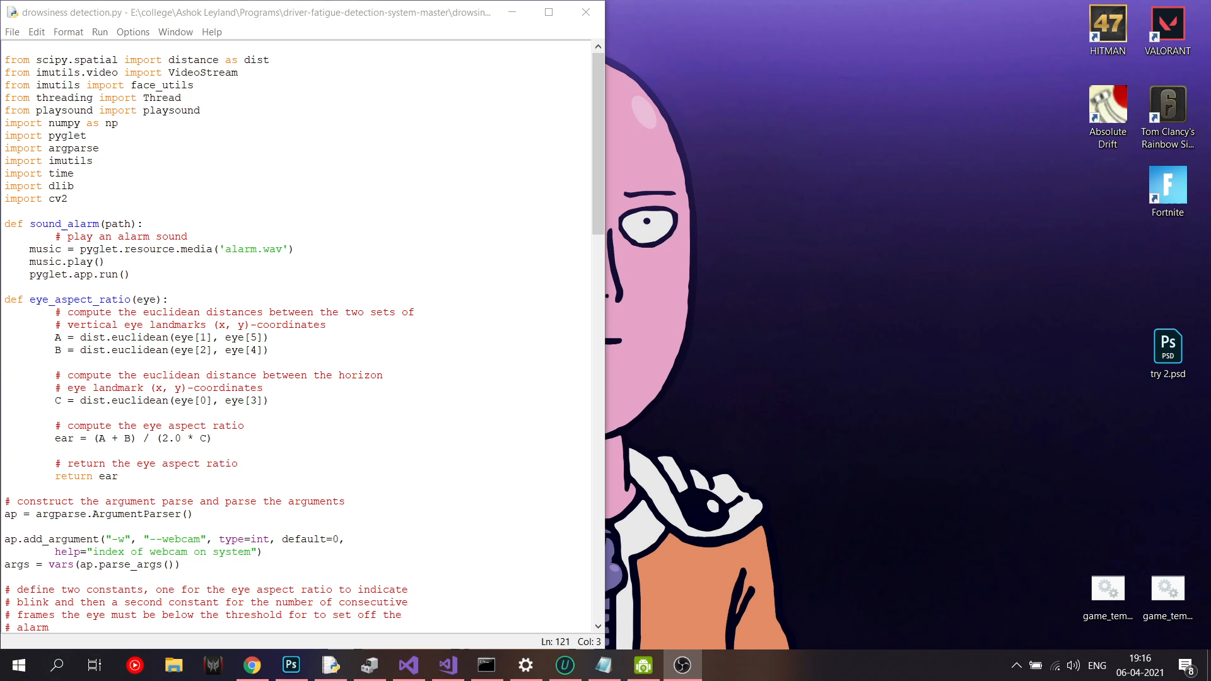
VALIDATION INFORMATION
The program was tested with webcam and run without any error on pc.

Slide 5
Future Works
Currently finished the basic algorithm using EAR, now we are trying to find to use ECG data in the project.
Further improvements on the basic algorithm to be made.
Project may show error during the usage of glasses.

